Slide 1


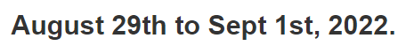
SHE: A Generic Framework for Data Stream Mining over Sliding Windows
Yuhan Wu, Zhuochen Fan, Qilong Shi, Yixin Zhang, Tong Yang, Cheng Chen, Zheng Zhong, Junnan Li, Ariel Shtul, Yaofeng Tu.
Notes:
Hello everyone! I’m Yuhan Wu, a first-year Ph. D. student from Peking University.
Today I will present our work: SHE: A Generic Framework for Data Stream Mining over Sliding Windows
0:17

Slide 2
Stream Processing
Workflows
Membership
Cardinality
Frequency
…more
User Query
Input Stream
Dedicated Platforms:
Network Switches
FPGA/ASIC
...
Query Results
Notes:
In this paper, we focus on extremely high-speed data stream processing. For example, the packet stream in the network.
To handle the high-speed stream, we often process the stream in dedicated hardware platforms, including Network switches FPGA and ASIC.
As the latest stream data arrives, at any time, the user can query the stream data, and we should answer the query and output the results.
0:38

Slide 3
Processing Models
fixed windows and sliding windows
Window 1
Window 2
Window 3
Fixed window
a
b
c
a
e
a
c
b
a
a
Time
Processing Algorithm
Processing Algorithm
Reset to 0!
Reset to 0!
Results of window 1
Results of window 2
Membership: Does “a” appear in window 1? Yes.
Cardinality: How many distinct items are there in window 1? 4 items.
Frequency: How many times does “a” appear in window 1? 2 times.
…more
User Query
Notes:
There are two common stream processing models: the fixed window model and the sliding window model.
First, we show how fix window model works. The fixed window model divides the data stream into multiple windows of the same size, processes each window independently, and reports the result only at the end of each time window.
There are many kinds of user queries. For example, the membership query asks whether one item appears in one specific window. The cardinality query asks the number of distinct items in one window.
Now, we show how the processing algorithm works by an example. As time goes on, item a, b, c, a, e arrive and are inserted into the processing algorithm. The algorithm reports the query result at the end of window 1. For membership, item a did appear in window 1. There are four distinct items in window 1 and item ‘a’ appears two times.
After the report, the algorithms and data structures in the processing platform are reset to zero. Then the new items in the next window will be inserted.
1:30

Slide 4
Processing Models
fixed windows and sliding windows
Sliding window
6
7
8
9
0
Time
Processing Algorithm
1
2
3
4
5
window size=5 (items)
Membership: Does “a” appear recently/in the sliding window? Cardinality: How many distinct items are there in the sliding window?
Frequency: How many times does “a” appear in the sliding window?
…more
User Query
Notes:
Then, we show how sliding window model works.
The sliding window focuses on the most recent data item arrivals. The window size can be defined by either the number of items or the real time.
In this example, the window size is five items.
The processing algorithm always focuses on those items in the sliding window.
The user can send queries of the sliding window at any time.
Compared with the fixed window model, sliding window can answer the query just in time, but the fixed window can only answer the query at the end of each fixed time window.
In this paper, we aim at the sliding window model.
0:53
2:30

Slide 5
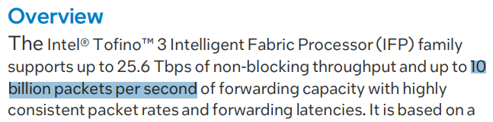
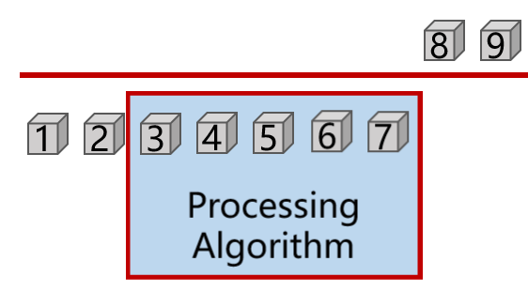
Approximate Algorithms
in data stream processing
Idea: Store all items in the window and build many indexes.
Weakness: Not practical for dedicated hardware platforms.
Huge data volume (GBs): up to billions of items (network packets) in the 1-second time window.
Small memory size (<30 MB): FPGA, ASIC and Switches.
Exact & nearly-exact solutions
memory efficient & tolerable errors
Including: Bloom filter, Bitmap, HyperLogLog, Sketches, and more
Weakness:
Deletion is not supported and not applicable to sliding windows
Approximate algorithms for fixed windows
Delete
Sliding window
Notes:
There are two types of related work: exact solutions that can answer the query with no errors, and approximate algorithms that have small and tolerable errors.
The key idea of the exact solution is to store all items in the sliding window and build many indexes on them. When a new item comes and inserts, it delete the oldest item in the sliding window.
When the data volume and data speed is relatively small, the exact solutions can work well in CPU platform.
However, in the extremely high speed scenario, it is not practical for dedicated hardware platforms. In a network switch, there are billions of items to be inserted in one second, but the memory of switch is too small to store all items in one window.
Therefore, the high-speed stream processing in both fixed window and sliding window often chooses the approximate algorithm. Because their memory cost is small enough for hardware platforms and their errors are tolerable.
The Approximate algorithms for fixed windows have a long history. Typical work includes the bloom filter, bitmap, hyperloglog, and sketches.
However, most of these approximate algorithms are not applicable for the sliding window model due to the problem of cleaning outdate items. In the fixed window model, we can reset all to zero at the end of the fixed window. But the sliding window only clears those outdated items that leave the sliding window. The basic version of these approximate algorithms do not support deleting items. And their variants for sliding windows focus on single task.
2:00

Slide 6
Our Proposed Framework
namely Sliding Hardware Estimator (SHE)
Our Proposed Framework
 | Fixed-window Approximate Algorithms
Sliding Window | Not Support
Memory | Small
Speed | Fast
Accuracy | High
Dedicated Hardware | Support
Sliding-window Approximate Algorithms
Support
Small
Fast
High
Support
Transform
Preserve
Who? What fixed-window approximate algorithms does the framework transform?
How? How the framework supports sliding and preserves existing advantages?
Notes:
The design goal of this paper is to devise a generic framework that transforms many existing fixed window algorithms to sliding windows on hardware platforms.
Thereafter, we can perform various sliding window queries of high speed stream on dedicated hardware.
Besides, we try to keep the advantages of existing algorithms, including small memory, high speed, high accuracy, and hardware support.
The next two questions are: What fixed-window approximate algorithms does the framework transform?
We do not have to transform all algorithms and also we cannot transform all of them.
Second, how we devise the framework to achieve the design goal?
To answer the first question, we first introduce one approximate algorithm called Bloom filter and then we summarize the common characteristics of approximate algorithms.
1:10

Slide 7
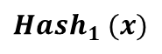
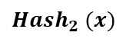
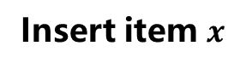
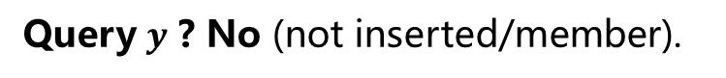
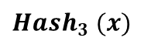
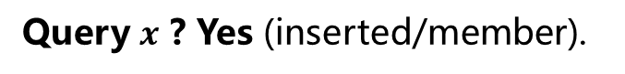
Bloom filter
one approximate algorithm for membership query
1
0
1
1
0
1
0
1
$${Hash}_{1} (x)$$
Query $x$ ? Yes (inserted/member).
If all selected bits are 1, report Yes.
Insert item $x$
$${Hash}_{2} (x)$$
Set all selected bits to 1
Query $y$ ? No (not inserted/member).
$${Hash}_{3} (x)$$
If any selected bit is 0, report No.
Bit “1” implies that some items have been inserted here
Bit “0” implies that no item has been inserted here
Notes:
The Bloom filter is an algorithm for membership query. Membership query asks whether an item is a member of the past data stream.
The Bloom filter has an array of many bits. They are all zero at initial.
Every time a new item comes, it selects k bits by hashing and set all these k bits to 1.
To query one item, it access the k bits by the same hash functions. It reports Yes if all selected bits are 1 and reports No if there is at least one bit being 0.
Consider one specific bit in the Bloom filter. The bit of “1” implies that some items have been inserted here. The bit of “0” implies that no item has been inserted here.
60
6:30

Slide 8
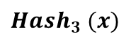
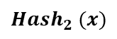
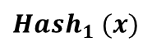
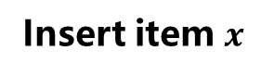
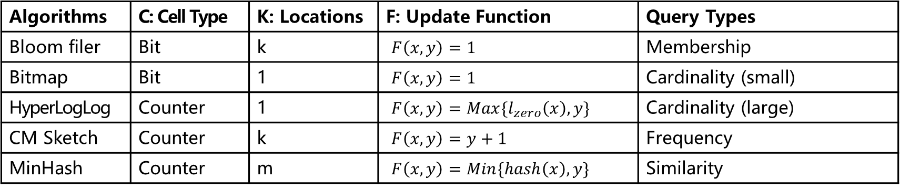
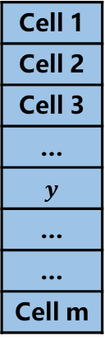
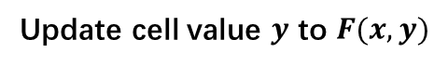
Common Model
of Fixed-window Approximate Algorithms
Cell Type: bit/counter
Cell 1
Cell 2
Cell 3
…
$$y$$
…
…
Cell m
$${Hash}_{1} (x)$$
Insert item $x$
$${Hash}_{2} (x)$$
Update cell value $y$ to $F(x,y)$
$${Hash}_{3} (x)$$
Algorithms | C: Cell Type | K: Locations | F: Update Function | Query Types
Bloom filer | Bit | k | $F\left(x,y\right)=1$ | Membership
Bitmap | Bit | 1 | $F\left(x,y\right)=1$ | Cardinality (small)
HyperLogLog | Counter | 1 | $F\left(x,y\right)=Max\{l_{zero}\left(x\right),y\}$ | Cardinality (large)
CM Sketch | Counter | k | $F\left(x,y\right)=y+1$ | Frequency
MinHash | Counter | m | $F\left(x,y\right)=Min\{hash\left(x\right),y\}$ | Similarity
Notes:
Here, we summarize a common model of fixed-window Approximate Algorithms. It includes more than five algorithms for various query types.
First, all these algorithms has an array of cells. The cell can be a bit or a counter.
Second, when inserting items, these algorithm update one or more cells.
Third, when updating the cell, the new value can be decided by the update function.
These algorithms can answer different kinds of queries. We can arbitrarily select some algorithms to deploy according to the query type that needs to be answered.
For easy understanding, we still use BF as an example to introduce our framework.
1:00

Slide 9
Our Proposed Framework
namely Sliding Hardware Estimator (SHE)
Design requirements of the framework
Clear outdated (out of sliding window) information
Keep small memory
Keep high accuracy
Meet hardware constraints by simple designs.
Sliding Window | Support
Memory | Small
Speed | Fast
Accuracy | High
Dedicated Hardware | Support
Notes:
To achieve the design goal, we give four design requirements of the framework.
First, the framework needs to clear the outdated information but cannot reset the whole data structure to zero.
Second, it should keep small memory in order to meet the memory constraint of hardware platform.
Third, it should keep high accuracy to provide high-quality answers for the user.
Finally, the operations of the framework should be hardware friendly, so that the speed will be fast enough.
0:40
8:10

Slide 10
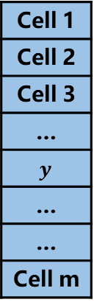
Cleaning Process
Sliding window
1
2
3
4
5
6
7
8
9
0
Time
Cell 1
Cell 2
Cell 3
…
$$y$$
…
…
Cell m
Notes:
To meet the design requirement, we use a cleaning process to clear outdated information with the minimal memory cost.
The process scans the whole data structure with a constant speed from the first cell to the last cell periodically.
When scanning a cell, the process resets it to zero. At the same time, new items arrive and are inserted into the data structure.
Here we show an example. Every time a new item arrives, the cleaning process will move to the next cell.
First, the process clean the first cell, and the first item is inserted. Then the process clean the second cell and the second item is inserted.
0:50

Slide 11
Cleaning Process
Sliding window
1
2
3
4
5
6
7
8
9
0
Time
Cell 1
Cell 2
Cell 3
…
$$y$$
…
…
Cell m
One historical version
The current version
Notes:
Here, we show all historical versions of the data structure in the figure. In the matrix, each column represents a version of the data structure at different time.
We mark the movement track of the cleaning process with a yellow vertical line. If the line on the left of a cell is yellow, it means that the cell has just been cleared.
0:25

Slide 12
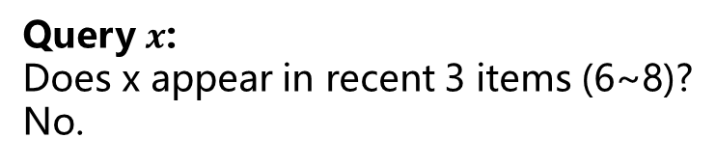
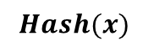
Cleaning Process
Sliding window
1
2
3
4
5
6
7
8
9
0
Time
Age=2
Cell 1
Cell 2
Cell 3
…
$$y$$
…
…
Cell m
 |  |  |  |  |  |  | 0
 |  |  |  |  |  |  | 1
 |  |  |  |  |  |  | 0
 |  |  |  |  |  |  | 1
 |  |  |  |  |  |  | 1
 |  |  |  |  |  |  | 0
Item 7, 8 have never selected/inserted here
Age=6
Item 3~8 have never inserted here
Age=4
Some items in 5~8 are inserted here
$$Hash(x)$$
Query $x$:
Does x appear in recent 3 items (6~8)?
No.
Bloom filter with 6 cells
Window size = 3 items
Notes:
We know that every cell has recorded the information since it was last cleared.
We call the duration of each cell recording information as age.
For example, suppose the data structure is a Bloom filter with 6 cells and the sliding window size is 3 items.
After the insertion of the 8-th item, we find that the first cell of the bloom filter is zero.
We can calculate that the last time cell 1 was cleared was before the insertion of item 7.
Therefore, the age of the first cell is 2. Since the first cell is zero, it means that item 7 and 8 have never selected or inserted in the first cell.
Similarly, the 3-rd cell is zero. It means that item 3 to 8 have never inserted to the third cell.
The 5-th cell is 1 means that some items in 5 to 8 are inserted to the 5-th cell.
When the user query an item x, we calculate its hash values and select the 1-st 3-rd and 5-th cells. From the 3-rd cell, we know that no item in 3 to 8 inserted. Therefore, item x must never appear in the sliding window, which is item 6-8.
1:40

Slide 13
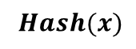
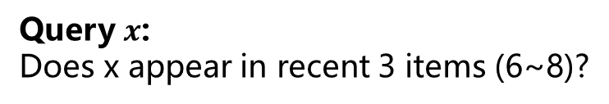
Cleaning Process
Sliding window
1
2
3
4
5
6
7
8
9
0
Time
Cell 1
Cell 2
Cell 3
…
$$y$$
…
…
Cell m
 |  |  |  |  |  |  | 0
 |  |  |  |  |  |  | 1
 |  |  |  |  |  |  | 0
 |  |  |  |  |  |  | 1
 |  |  |  |  |  |  | 1
 |  |  |  |  |  |  | 0
Query $x$:
Does x appear in recent 3 items (6~8)?
$$Hash(x)$$
Any “0” bit has an age no less than the window size→ Report No.
Otherwise → Report Yes.
Age: the time since last cleaning
Bloom filter with 6 cells
Window size = 3 items
Notes:
So what is the formal query method?
When the user queries item x, we find all its selected bits by hashing, then check if any zero bit has an age no less than the window size. If so, we are sure that the item must never appeared in the sliding window.
Otherwise, we report Yes, which may be a wrong answer with a small probability.
0:30
11:30

Slide 14
Cleaning Process
Insight:
Cleaning process with constant moving speed
Cells with known ages
New query strategy that refers to ages
1
2
3
4
5
6
7
8
Time
 |  |  |  |  |  |  | 0
 |  |  |  |  |  |  | 1
 |  |  |  |  |  |  | 0
 |  |  |  |  |  |  | 1
 |  |  |  |  |  |  | 1
 |  |  |  |  |  |  | 0
Bloom filter (Traditional)
Any “0” bit appears→ Report No.
Otherwise → Report Yes.
Bloom filter (New query strategy)
Any “0” bit has an age no less than the window size→ Report No.
Otherwise → Report Yes.
Notes:
Our insight is to use a cleaning process with constant moving speed.
Then, based on the speed and the different position of each cell, we can calculate the age of each cell.
Finally, we update the query strategy of traditional fixed window algorithms.
For a Bloom filter in the fixed window model, it report yes if any selected bit is zero.
Now, in the sliding window model, only when one zero bit has an age no less than the window size, we report yes.
0:30

Slide 15
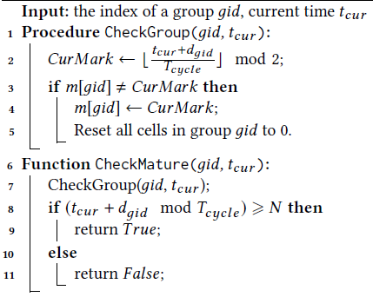
Cleaning Process
Time
0 | 0 | 0 | 0 | 0 | 0 | 1 | 1 | 1 | 1 | 1 | 1 | 0 | 0 | 0 | 0 | 0 | 0 | 1
1-bit Time Mark:
Cell 1
More techniques:
1-bit Time Mark
Group cleaning
Notes:
However, the cleaning process is not easy to implement and may cause write conflicts with the insert operation.
Therefore, instead of using an additional process to perform the cleaning operation, we devise a lazy cleaning strategy based on the 1-bit time mark. The detailed introduction can be found in our paper.

Slide 16
Our Proposed Framework
Sliding Hardware Estimator (SHE)
Clear outdated information: cleaning process
Keep small memory: <5% memory expansion
Keep high accuracy: new query strategies
Hardware constraints: Simple operations.
Notes:
Our framework SHE meets the four design requirements.
First, it can clear outdated information by cleaning process.
Second, it only requires small additional memory to record the 1-bit time mark.
Third, it can achieve high accuracy by new query strategies.
Finally, its operations are simple to meet the hardware constrains.

Slide 17
Experimental Results
Settings
Platform: CPU and FPGA
Datasets: CAIDA (Network traffic), Campus(Network traffic), WebPage(Network traffic), Distinct (Simulated), Relevant (Simulated)
Algorithms and query tasks: Bloom filter (Membership), Bitmap (Cardinality), Hyperloglog (Cardinality), Count-Min Sketch (Frequency), and Minhash (Similarity)
Notes:
We implement our framework in both CPU and FPGA platforms.
In the experiments, we use three real stream datasets and two simulated datasets.
Our framework SHE combines with five algorithms and answers their corresponding query tasks.

Slide 18
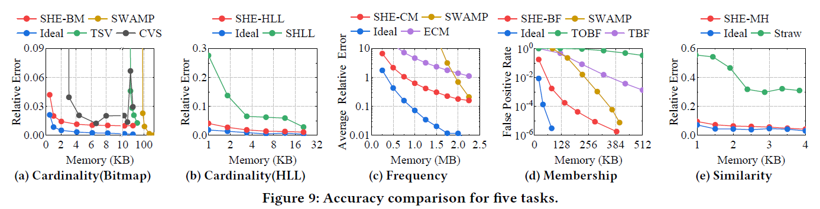
Experimental Results
Accuracy and memory cost
Red point: Our framework
Ideal: The performance in the fixed window model
SHE-BF: Our framework combined with Bloom filter
SHE-BM: Our framework combined with Bitmap
Notes:
We compare the accuracy of SHE with both the related work and the ideal goal in each query task.
The related work includes both general sliding window algorithms and many variants of each approximate algorithm.
The ideal goal for each query task is the accuracy achieved if we treat the sliding window task as a fixed window task. For example, we insert all items in the sliding window to an empty Bloom filter [10], and calculate the membership accuracy as the ideal goal.
Our experiments show that our framework achieves the best accuracy when the memory is small in every task. When the memory is large and sufficient, our framework is not the best one.

Slide 19
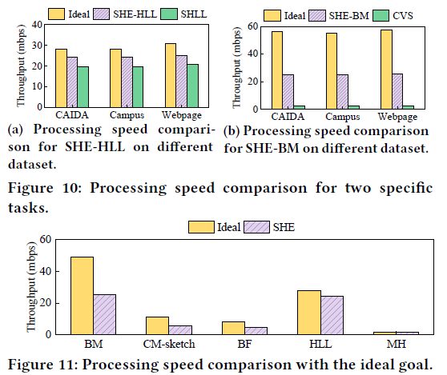
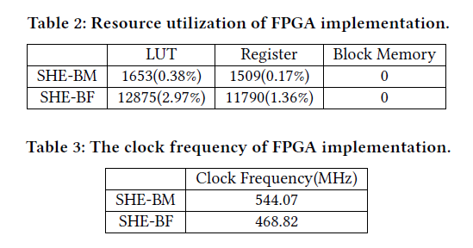
Experimental Results
Processing speed on CPU and FPGA
Notes:
We test the speed of SHE combined with five algorithms on CPU platform.
The ideal is also the original algorithm in the fixed window.
The results in figure 10 and 11 shows that SHE only slows down a little speed in each algorithm.
We implement SHE combined with Bloom filter and Bitmap in FPGA. The results show that SHE can achieve high speed in the hardware platform.

Slide 20
Conclusion
SHE: a generic framework that can extend common fixed window algorithms to sliding windows.
Small memory cost, high speed, high accuracy, and dedicated hardware support.
We combine SHE with five well-known fixed window algorithms.
We implemented SHE on both CPU and FPGA. All codes are released at Github.
Notes:
In this paper, we propose SHE: a generic framework that can extend common fixed window algorithms to sliding windows.
It has small memory cost, high speed, high accuracy, and supports dedicated hardware platform.
We combine SHE with five well-known fixed window algorithms and implement it on both CPU and FPGA platforms. All our codes are released at Github.

